Slide 1
Containerization Series:
Part 1

Slide 2
Intro

Slide 3
Agenda (1/2)
Container runtime History, Flavors of runtime, Supported operating systems
Docker for windows quick demo / walk through
My first (Sony) container
View runtime container processes
Eco system Who are the key players, what do they bring to the table and what should we look for
Ecosystem
Dashboards
Roadmaps
Container images Why do we need container images?
Layers,
Storage drivers,
Build file,
Version / Tags

Slide 4
Agenda (2/2)
Networking Type of network layers, Interaction between running containers, Publish ports
Create 2 (running) containers that interact with each other on the private network
Expose the web port to the outside and access application.
Volumes / storage
Map simple container to local volume and modify file in and outside container
Compose
Build, dependencies, network
compose up (repository / tags)
Visual studio and docker support
Setup a visual studio project with docker support
Debug running containers
Hack your own solution

Slide 5



Containerization vs Virtualization
App 1
App 2
Guest OS
Guest OS
App 1
App 2
Hypervisor
Docker Engine
Host OS
Host OS
Infrastructure
Infrastructure

Slide 6
Container runtime (short history)
1979 Unix v7
2000’s Many initiatives (freebsd jails)
2006 Google’s CGroups added to Linux Kernel
2013 Docker containers
Notes:
You might be surprised to learn the earliest versions of container technology date back to 1979. Unix V7 usually gets the credit for the earliest representation through chroot system call, creating early process isolation.
Not until 2000 did containers become a major technology. At this point, FreeBSD jails came to prominence via Derrick T. Woolworth at R&D Associates. Woolworth created the basic technologies behind containers, yet was still quite rudimentary.
Google got into the container business by 2006 with their Process Containers. One year later, they renamed this Control Groups and added to the Linux Kernel. It was proof of how much Google contributed to evolving containers by merging with previous systems.
It started in 2013 as a PaaS called dotCloud, then renamed to its current brand name. What made Docker stand apart is how they designed their own system to manage images.

Slide 7
Container runtime (flavors)
The word “container” doesn’t mean anything super precise. Basically there are a few new Linux kernel features (“namespaces” and “cgroups”) that let you isolate processes from each other. When you use those features, you call it “containers”.
Namespaces:
in a pid namespace you become PID 1 and then your children are other processes. All the other programs are gone
in a networking namespace you can run programs on any port you want without it conflicting with what’s already running
in a mount namespace you can mount and unmount filesystems without it affecting the host filesystem. So you can have a totally different set of devices mounted (usually less)
CGroups:
limits, accounts for, and isolates the resource usage (CPU, memory, disk I/O, network, etc.) of a collection of processes
Resource limiting – groups can be set to not exceed a configured memory limit, which also includes the file system cache^{[8][9]}
Prioritization – some groups may get a larger share of CPU utilization^{[10]} or disk I/O throughput^{[11]}
Accounting – measures a group's resource usage, which may be used, for example, for billing purposes^{[12]}
Control – freezing groups of processes, their checkpointing and restarting^{[12]}

Slide 8
Container runtime (flavors)
Layering of functionality.
Low level runtimes: First layer of scripting to control creation of namespaces and cgroups for containers and build a filesystem and manage the process access (chroot).
Lmctfy: google’s internal runtime for Borg)
Runc: most popular and build as part of the Docker initiative
Rkt: rkt is a popular alternative to Docker/runc that was developed by CoreOS. Bit confusing since it contains high level features as well.
High level runtimes: Add image formats, image management, and sharing images. And add an API’s to interact
Containerd: Docker runtime
Rkt: CoreOS alternative/challenger since 2014
Cri-o (kubernetes)

Slide 9
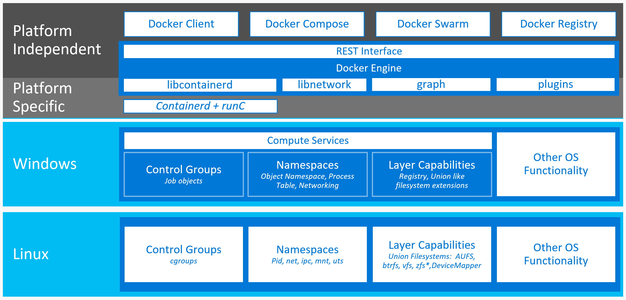
Docker architecture; Linux vs Windows
Microsoft needed to build new features into windows to mimic same Api layer to Docker
Docker is natively ported (and open source in the same repository as Docker for linux)
Windows is natively a very integrated OS (loads of default dependent services) vs. Linux which is highly modular
Special isolation mode available hyper-v

Slide 10
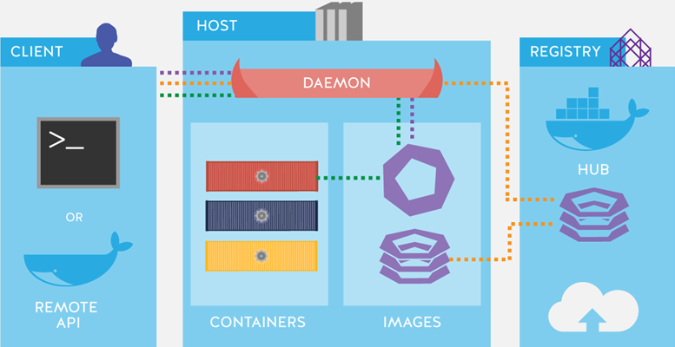
Docker runtime architecture

Slide 11
Container runtime (Supported operating systems)
Most interesting eco-systems:
Kubernetes
Docker
Operating systems that support Docker / Kubernetes runtime:
All major Linux versions
Windows 10 Anniversary Edition or Creators Update (Docker for Windows)
Windows Server 2016

Slide 12
Docker for windows
Special distribution that can run in 2 modes (Linux and windows containers)
Uses dockerd.exe for windows containers (Hyper-v isolation mode)
Uses Mobilinux Hyper-v Virtual machine for linux containers
Is meant for development only
Unable/unwanted to modify virtual machine, may have limitations (i.e. using GPU)

Slide 13
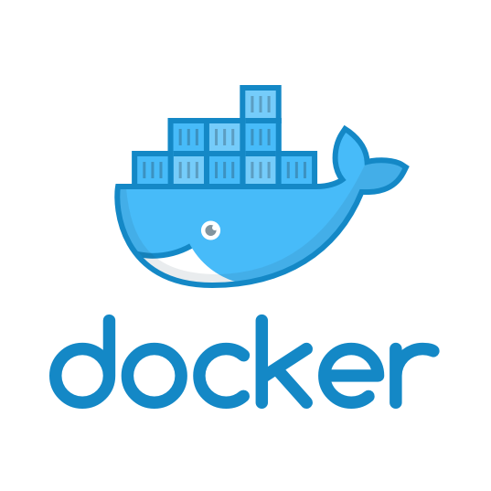
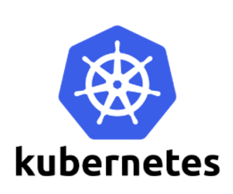
Eco System
Main competitors, different focus.
Kubernetes
Has been around longer and tooling has been developed further
Advanced scenarios: More descriptive layers to describe aspects of your application allowing more control (Kubernetes pods vs docker services)
Docker (Enterprise)
Is simpler to understand and use
Has more focus on workflow and security
Docker now adopts Kubernetes into their enterprise solution
Microsoft (and Avanade) have strong relationship with Docker

Slide 14
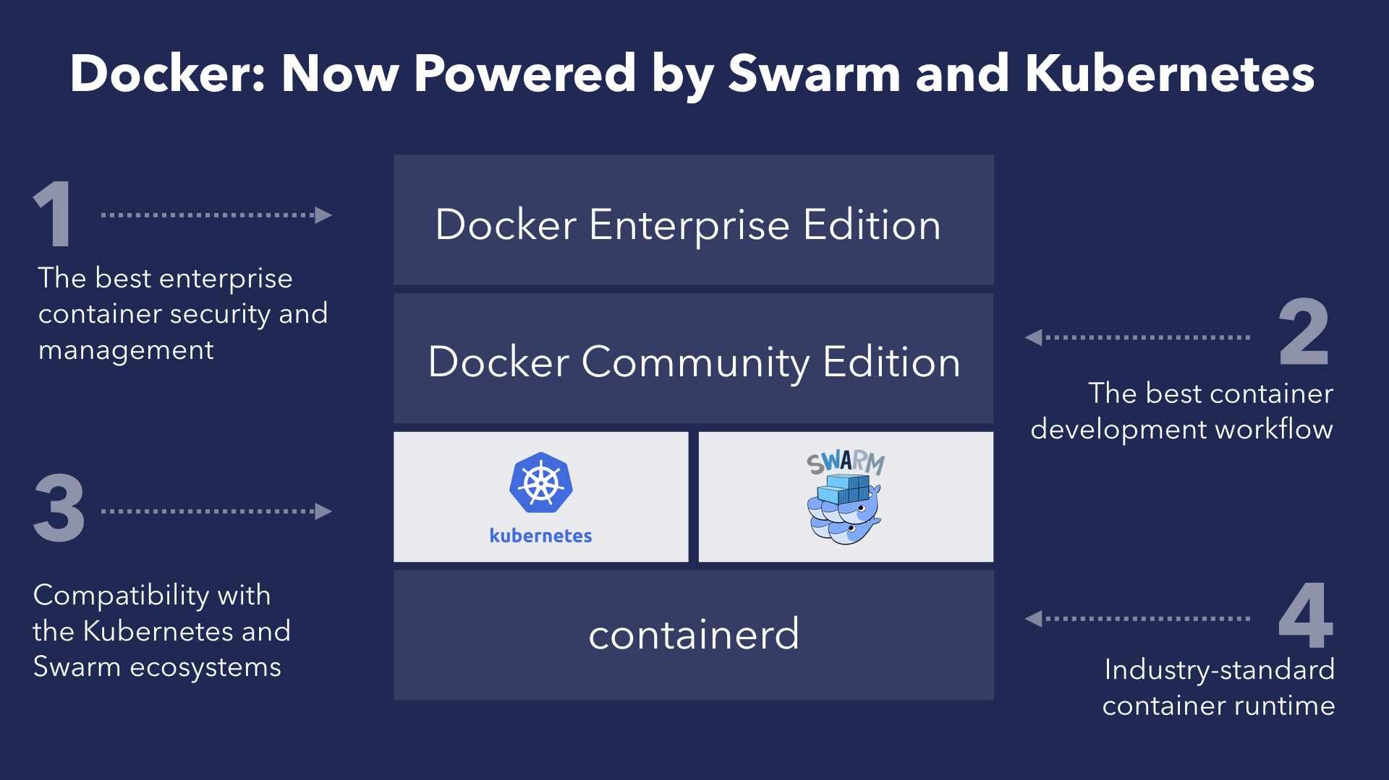
Docker embraces Kubernetes

Slide 15
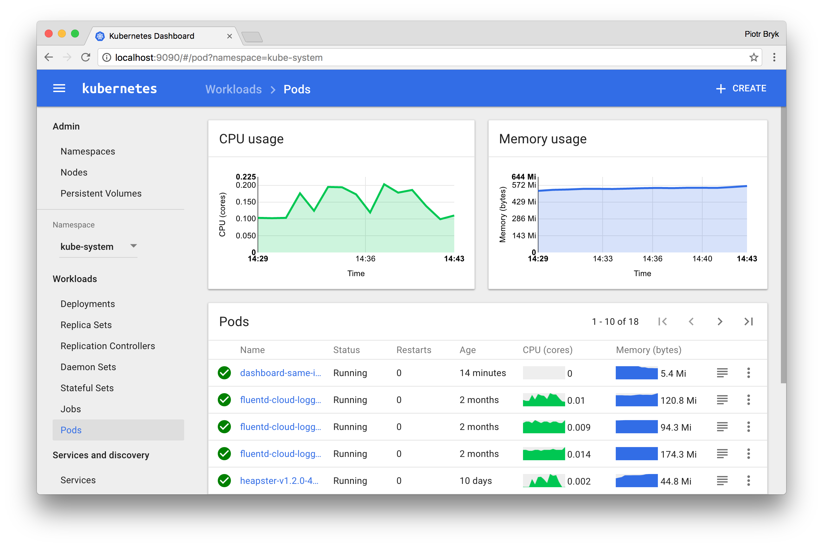
Kubernetes dashboard

Slide 16
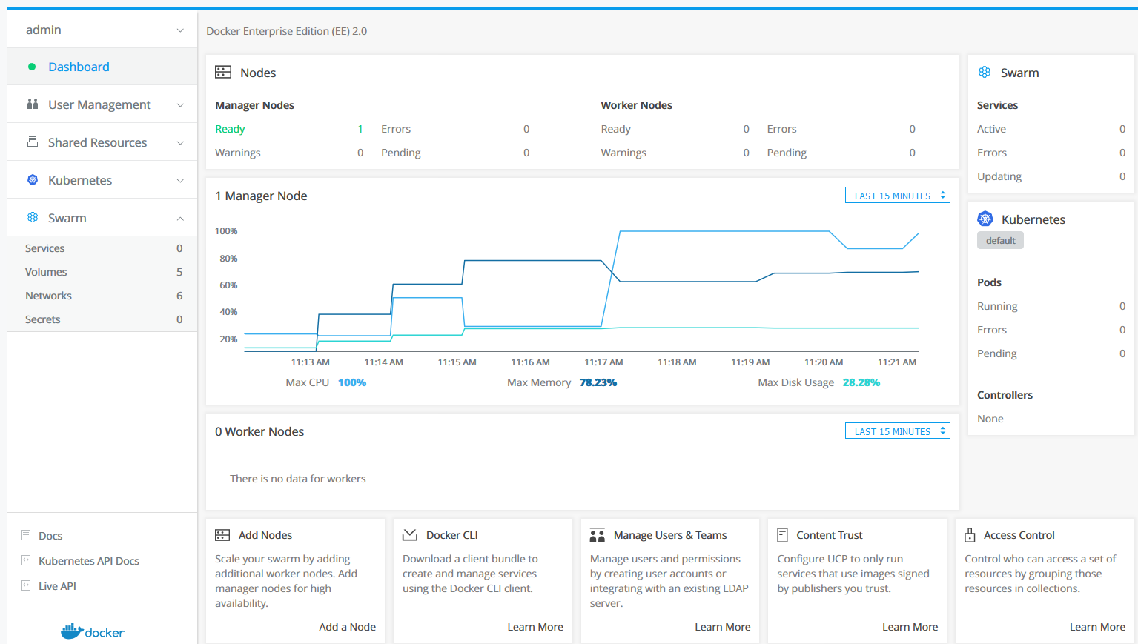
Docker Enterprise
Universal Control Plane is a cluster management solution that allows you to deploy and monitor your applications across machines.
Docker Trusted Registry manages your images, storing them securely and scanning them for vulnerabilities. If you click on it now you will see the Tomcat image we will deploy.
Admin Console is a terminal to the cluster. Here you can directly run commands to deploy and manage your applications. Try running docker info to check the status of the cluster.

Slide 17
Microsoft - Docker collaboration
Build
Docker for Windows
Docker EE for Windows Servers
Visual Studio Tools for Docker
Visual Studio Code Docker extension
Ship
Visual Studio Team Services Docker Integration
Azure Container Registry
Run
Docker EE in Azure Marketplace
Docker on Azure Stack
Version | Compatiblity
EE 2.0.0 GA | Only Windows Server 2016 (RS1) Supported Easy Image Compatibility: No Ingress Networking: No
EE 2.0.x | Add Windows Server 1709 (RS3) support with partial features: Easy Image Compatibility: Yes Ingress Networking: No
EE 2.1 (Q3) | Full Support for Windows Server 1709 Easy Image Compatibility: Yes Ingress Networking: Yes Tentative Considerations: Windows Server 1803 (RS4) support

Slide 18
Lab 1: Start my first (Sony) container (Walkman)
Using Docker for windows (which everyone should have installed as a prerequisite) View your images with: docker image ls microsoft/aspnet:aspnet:4.7.1-windowsservercore-ltsc2016 (in the list of results)
Run a container [start a container process with in the background (-d)] docker run –d –name myfirstsony microsoft/aspnet:4.7.1-windowsservercore-ltsc2016 shows the container id of the started container
View running container docker ps list of running container processes it should contain the container id and name of the process started on 2
See inside the running container process (execute cmd.exe and attach interactively (-it) to the output) docker exec –it myfirstsony cmd Microsoft Windows [Version 10.0.16299.371] (c) 2017 Microsoft Corporation. All rights reserved. C:\>

Slide 19
Images - What is a docker image?
Processes running in containers are isolated from the outside world, e.g.:
No access to docker host filesystem
No access to docker host network
All files required to run a process in a container reside in an image, e.g:
OS (NanoServer / ServerCore / Linux)
.NET (version x / core)
Custom application dependencies
Images are stored in a registry - a scalable server side application that
Stores images
Distributes images
Docker hub is a free-to-use, hosted Registry

Slide 20
Images – Dockerfile
Images are built using a Dockerfile
Build instructions to create an image, e.g.:
Dockerfile reference → https://docs.docker.com/engine/reference/builder/#usage
FROM microsoft/nanoserver
RUN md \Lab2
COPY get-name.ps1 \Lab2
CMD ["powershell","c:\\Lab2\\get-name.ps1"]

Slide 21
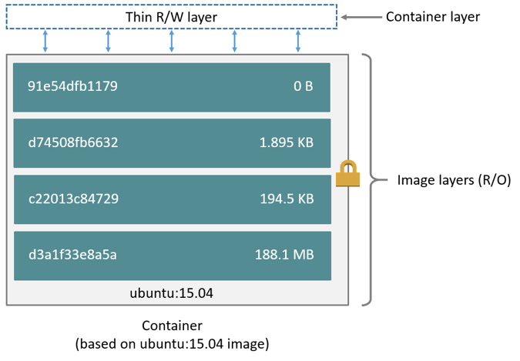
Images – Layers
An image consists of 1 or more layers
Each command in a dockerfile adds a new layer
Each layer is only a set of differences from the layer before it
‘docker pull [image:tag]’ downloads all image layers locally
Step 1/4 : FROM microsoft/nanoserver
---> 353592ac9faa
Step 2/4 : RUN md \Lab2
---> Running in 6b0b515714d9
---> 7a2985fb59c7
Removing intermediate container 6b0b515714d9
Step 3/4 : COPY get-name.ps1 \Lab2
---> c0fced06b306
Removing intermediate container f908f8b275bb
Step 4/4 : CMD powershell c:\Lab2\get-name.ps1
---> Running in e4a2e2bacbae
---> 43ec2e2a96da
Removing intermediate container e4a2e2bacbae
Successfully built 43ec2e2a96da

Slide 22
Images – Storage Drivers
A container is using a docker storage driver to read and write files from an image
For most purposes default (overlay2) is ok
Decision to select a different driver depends on
Underlying filesystem / device
Container purpose
Please see https://docs.docker.com/v17.09/engine/userguide/storagedriver/selectadriver/

Slide 23
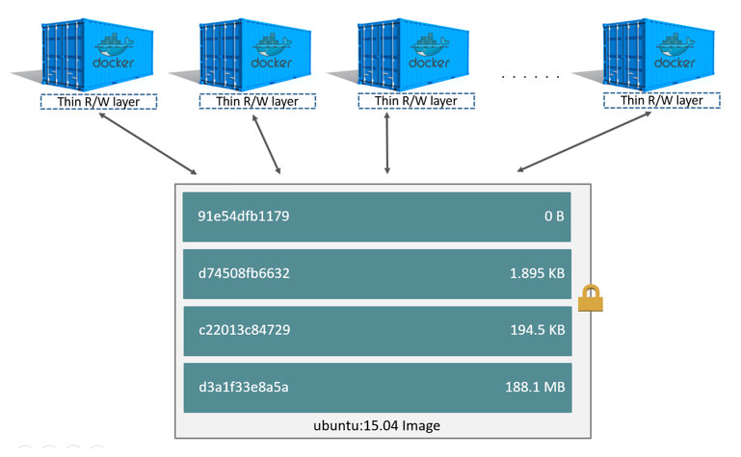
Images – Container layer
Each started container has its own writeable layer on top of the underlaying layers (container layer)
All changes made to files, are written to this layer

Slide 24
Images - Tags
Tags are used for image versioning / identification in registries
An image can have multiple names/tags
E.g.: ‘docker image ls’
The default tag is latest if omitted.
Repository (name) | Tag | ImageId
hello-world | latest | f5a633bbccab
hello-world | 1.0.0 | e38bc07ac18e
hello-world | 1.0.1 | f5a633bbccab

Slide 25
Lab 2: Images (1/3)
Required files: https://github.com/josibb/dockertraining1.git
High level steps:
Build a new docker image that output the hostname and pings the localhost
Create new container instance based on created image
Verify the container is running
Push (versioned) image to Azure Container Registry
Remove tags and images
Create new container instance based on pushed image
Verify the container is running (see step 3)
Interactively open shell inside the running container

Slide 26
Lab 2: Images (2/3)
Build a new docker image that output the hostname and pings the localhost
docker build –t lab2 .
docker image ls (lab2:latest image should be listed)
Create new container instance based on created image
docker run –d lab2
Verify the container is running
docker ps
docker logs [#container] (find #container in step a)
Push (versioned) image to Azure Container Registry
docker tag lab2 [NameOfContainerRegistry].azurecr.io/lab2:1.0.0
docker tag lab2 [NameOfContainerRegistry].azurecr.io/lab2
docker image ls (check tags and #image)
docker push [NameOfContainerRegistry].azurecr.io/lab2
(In Azure Portal) - check the container registry to find the pushed image(s)

Slide 27
Lab 2: Images (3/3)
Remove tags and images
docker rm [NameOfContainerRegistry].azurecr.io/lab2:1.0.0
docker rm [NameOfContainerRegistry].azurecr.io/lab2
docker rm lab2 (a container started in step 2 is still running preventing this image to be removed, please stop and remove the running container using ‘docker stop #container’ and ‘docker rm #container’
Create new container instance based on pushed image
docker run -d [NameOfContainerRegistry].azurecr.io/lab2
Verify the container is running (see step 3)
Interactively open shell inside the running container
docker exec –ti [#container] cmd

Slide 28
Commandline reference documentation
https://caylent.com/docker-commands-cheat-sheet/
https://docs.docker.com/engine/reference/commandline/cli/

Slide 29
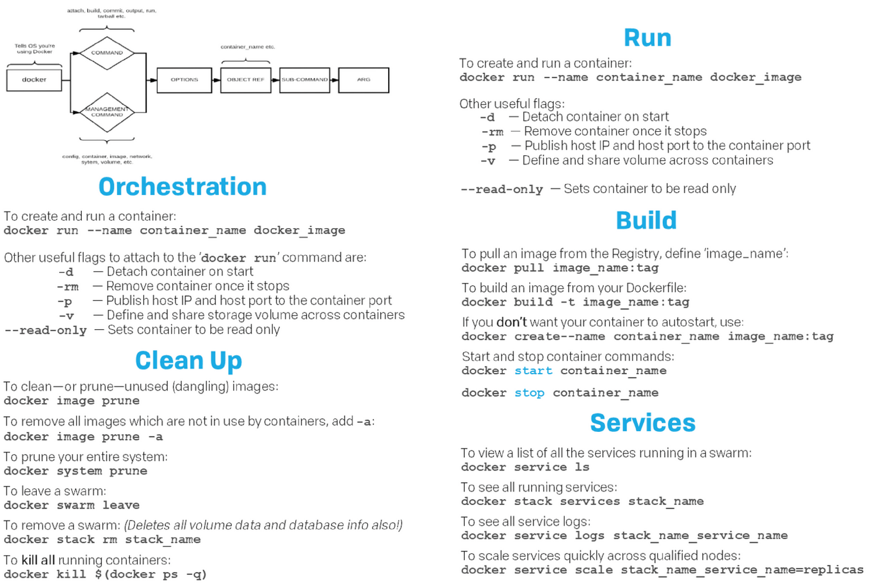
Docker basic commands (from the cheat sheet)
Notes:
docker inspect –format='{{range.NetworkSettings.Networks}}{{.IPAddress}}{{end}}'

Slide 30
Container storage
When a container is started a new temporary layer is put on top of the image (for general compatibility). The image remains read-only. The concept is Do not to store any data inside this temporary layer that needs to be persisted
Volumes allow you to map persistent storage into the container (as a directory)
!warning!: do not map sensitive data from the host system into an untrusted image
The base parameter layout for the use of a volume with a container is -v source:target:access
Examples: -v c:\ContainerData:c:\data:RO (maps c:\ContainerData readonly onto the path c:\data inside the container
If no source is provided (ie. –v c:\data:RW) docker will use a default storage location to create a volume for you

Slide 31
Container storage – windows containers
Default virtual size of C: of container is 20GB for compatibility, this can be override using --storage-opt "size=50GB"
Symlinks are resolved in the container. If you bind-mount a host path to a container that is a symlink, or contains symlinks - the container will not be able to access them.
SMB Mounts on Windows Server version 1709, a new feature called "SMB Global Mapping" makes it possible to mount a SMB share on the host, then pass directories on that share into a container. The container doesn't need to be configured with a specific server, share, username or password - that's all handled on the host instead. The container will work the same as if it had local storage.
Containers using Hyper-V isolation, including Linux containers on Windows Server version, use a simple read-only or read-write permission model. Files are accessed on the host using the LocalSystem account. If you get access denied in the container, make sure LocalSystem has access to that directory on the host. When the read only flag is used, changes made to the volume inside the container will not be visible or persisted to the directory on the host.
Windows Server containers using process isolation are slightly different because they use the process identity within the container to access data, meaning that file ACLs are honored. The identity of the process running in the container ("ContainerAdministrator" on Windows Server Core and "ContainerUser" on Nano Server containers, by default) will be used to access to the files and directories in the mounted volume instead of LocalSystem, and will need to be granted access to use the data. Since these identities only exist within the context of the container, not on the host where the files are stored, you should use a well-known security group such as Authenticated Users when configuring the ACLs to grant access to the containers.

Slide 32
Lab 3: Container volumes
Create a container with a locally mapped volume
Create a directory on the host disk that we will use for persistent storage mkdir c:\dockerdata
Run an interactive (-it) container using the based on the “microsoft/nanoserver” image where we map the directory to the path c:\data within the running container. (we start cmd interactively since it will keep running until exit is entered and to allow you to explore the running container). docker run -it -v c:/dockerdata:c:/data microsoft/nanoserver cmd prompt inside the container
Go into the directory c:\data and create a file named test.txt that we can inspect. cd c:\data echo hello > test.txt
Open a secondary command prompt or use explorer to view the created file outside of the container in the directory c:\dockerdata (confirm content).
Modify the content outside using notepad (add some text)
View the updated file inside the container type test.txt
Exit the container (in this case we stop the cmd process by exiting it nicely) exit
Validate the file still exists in c:\dockerdata

Slide 33
Container volumes - advanced
In windows the local driver only supports locally available disks (for now).
Starting with version 1709 of windows server support for SMB (file share) mapped volumes are supported by the local driver
Docker engine uses the concept of drivers to extend the volume capability
Nothing available for windows containers yet
On Linux drivers available for use with Cloud (Azure, etc.) storage.
Volumes can be managed separately from containers (not yet available for windows containers)

Slide 34
Networking (1/2)
Processes running in containers are isolated from the outside world, e.g.:
No access to docker host filesystem
No access to docker host network
Docker’s networking subsystem is pluggable, using drivers. Several drivers exist by default, and provide core networking functionality e.g.:
User-defined bridge networks are best when you need multiple containers to communicate on the same Docker host.
Host networks are best when the network stack should not be isolated from the Docker host, but you want other aspects of the container to be isolated.
Overlay networks are best when you need containers running on different Docker hosts to communicate, or when multiple applications work together using swarm services.
Macvlan networks are best when you are migrating from a VM setup or need your containers to look like physical hosts on your network, each with a unique MAC address.
Third-party network plugins allow you to integrate Docker with specialized network stacks.

Slide 35
Networking – Example (2/2)
Webserver to be externally available
Webserver need to communicate to Db
Webserver and Db container attached to bridge0 network (nat in windows)
Docker will provide ip addresses
Docker will provide name resolution for container ip addresses based on container name (and instance name)
Webserver port (80) is published on docker host port 32768 (docker run …. -p 32768:80)
Docker host
Webserver container (80)
Backend container (80)
eth
eth
bridge0 (webserver 80:32768)
eth
32768

Slide 36
Lab 4: Networking
Required files: https://github.com/josibb/dockertraining1.git
List the configured networks using the docker network command; Verify the nat network is listed
Start a (iis-frontend) container (image=nanoserver/iis), connect it to network ‘nat’ and publish port 80
Verify that the published port is mapped to the container:80 port by navigating to (IE) http://localhost:publishedPort. The iis welcome-page should be displayed. (published port can be found listing the running containers or docker port)
Inspect the nat network using docker network inspect. The frontend container must be listed as attached
Start a backend container (image=lab2) with name ‘backend’ and connect it to network ‘nat’
Open a (cmd ) shell in the frontend container and ping the backend container using it’s name

Slide 37
Docker compose
Compose is a tool for defining and running multi-container Docker applications
YAML file to configure your application’s services
Create and start/stop/build/restore all services from your configuration with a single command
Multiple instances of a application can be separated on single host by using project names (DEV,TST etc)
Common use cases
Simple creation of (development) environments
Automated testing (create application, run tests, stop application)
Deployments to (external) host
Not included in default docker installer, needs to be installed separately

Slide 38
Docker compose - YAML
Specifies all configuration and services (containers) for an application e.g.
Image builds
Networks
Published ports
Container runtime options
Docker-compose file format is versioned (latest version 3.6) and features are added
Reference:
https://docs.docker.com/compose/overview/
https://docs.docker.com/compose/compose-file/

Slide 39
Docker compose – YAML example(s)
Reference:
YAML to build application images
YAML to start application
YAML (combined)
version: '3'
services:
frontend.web:
image: frontendweb
build:
context: .\FrontEnd.Web
dockerfile: Dockerfile
backend.web:
image: backendweb
build:
context: .\BackEnd.Web
dockerfile: Dockerfile
version: '3'
services:
frontend.web:
image: frontendweb
ports:
- "80"
depends_on:
- backend.web
backend.web:
image: backendweb
version: '3'
services:
frontend.web:
build:
context: .\FrontEnd.Web
dockerfile: Dockerfile
image: frontendweb
ports:
- "80"
depends_on:
- backend.web
backend.web:
build:
context: .\BackEnd.Web
dockerfile: Dockerfile
image: backendweb

Slide 40
Docker compose – Start application
Docker-compose up:
Starts all services (containers) specified in the yaml file and configures all its dependencies e.g.
If images need building, they are built
If networking is needed, an application network is created (not supported yet in windows)
Volumes are mounted
Network ports are published
Syntax: docker-compose [-p projectName] up [options]
Options
-f yaml file to use. Multiple can be specified and will be combined. If omitted docker-compose.yml is used.
-d Run application in detached mode

Slide 41
Docker compose – Stop application
Docker-compose down:
Stops all services (containers) specified in the yaml file and configured dependencies e.g.
Created networks are removed
Syntax: docker-compose [-p projectName] down [options]
Options
-f yaml file to use. Multiple can be specified and will be combined. If omitted docker-compose.yml is used.
--rmi will remove container images

Slide 42
Docker compose – Build application
Docker-compose build:
Build all images specified in the yaml file
Syntax: docker-compose [-p projectName] build [options]
Options
-f yaml file to use. Multiple can be specified and will be combined. If omitted docker-compose.yml is used.

Slide 43
Lab 5: Docker-compose (1/2)
Required files: https://github.com/josibb/dockertraining1.git
Application description:
Backend
Base image: microsoft/aspnet:4.7.1-windowsservercore-ltsc2016
WebApi (/api/values) returning collection of values
Frontend
Base image: microsoft/aspnet:4.7.1-windowsservercore-ltsc2016
MVC – Home page can invoke backend to retrieve values (executed from frontend container)
Steps
Build the application images using docker-compose and the docker-compose.build.yml file
Start the application using the default docker-compose.yml file
Verify the containers are running

Slide 44
Lab 5: Docker-compose (2/2)
Verify the application is working by navigating to the homepage of the frontend and try to get the values from the backend
Stop the application and verify the containers are stopped
Start 2 instances of the application (e.g. DEV and TST)
List the running containers
Verify the applications are working by navigating to the homepage of the frontend and try to get the values from the backend
Stop both applications

Slide 45
Docker MTA

Slide 46
Docker support in Visual Studio
Visual studio 2017 15.6 has full support for docker for windows both on Windows 10 and Windows server 2106
Simply enable a project for docker support is a context action: This will generate solution items (compose files) and a local dockerfile to build an image from your project.
It will help you maintain your compose and docker files right from visual studio (just like config files templated for running debug/ build configured)

Slide 47
DEMO

Slide 48
BUILD 3TIER
yourself

Slide 49
Closing: Q/A

Slide 50
Notes
Github repo for labs: https://github.com/josibb/dockertraining1.git
https://4sysops.com/archives/windows-docker-networking-part-2-custom-network-types/
https://4sysops.com/archives/windows-container-networking-part-1-configuring-nat/
joost123/dockertraining-lab2

